Slide 1


Power BI Project-1
Data Science Job Salaries
Presented by: Sathishsagar Chanda

Slide 2
Project Overview
Analyzing data science job salaries using Power BI.
Dataset includes columns: work_year, experience_level, employment_type, job_title, salary, employee_residence, job_type, company_location, and company_size.
Objective: Identify trends in salaries based on job roles, experience, and company attributes.

Slide 3

Dashboard: Data Science Job Salaries
Key Insights:
- Higher salaries for remote jobs.
- Senior roles dominate total salary distribution.
- Employment type impacts salary levels significantly.
Photo: person using MacBook Pro
Photo by Campaign Creators
Powered by Unsplash

Slide 4

Dashboard: Company Details
Key Insights:
- Highest salaries observed in Russia, USA, and New Zealand.
- Large companies tend to offer higher salaries.
- Top-paying job titles include Data Analytics Lead and Principal Data Engineer.
Photo: scope image
Photo by Michael Schiffer
Powered by Unsplash

Slide 5
Key Findings
- Experience Level: Executives and seniors earn the highest salaries.
- Job Type: Remote work offers competitive salaries compared to onsite.
- Company Size: Large companies offer better compensation packages.
- Yearly Trend: Salaries have increased over the years.

Slide 6
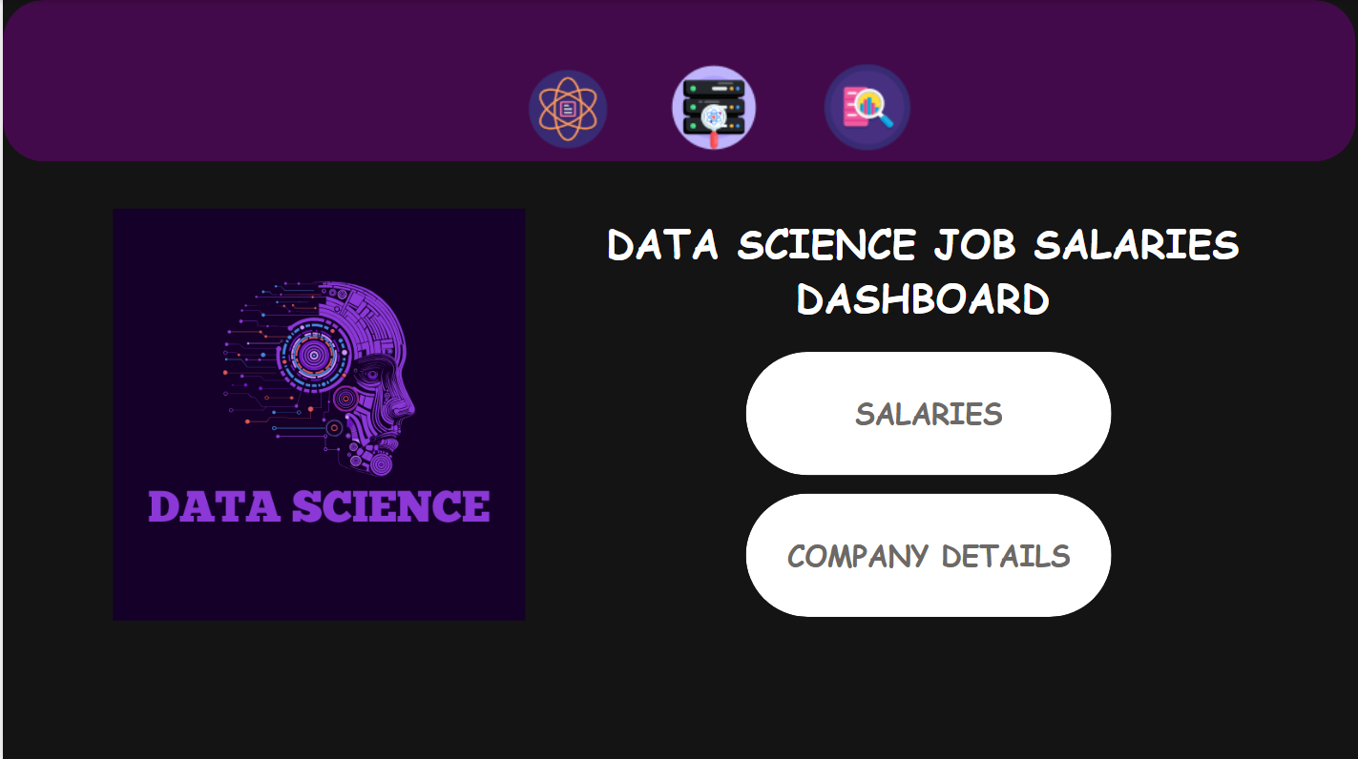
DASHBOARD:

Slide 7
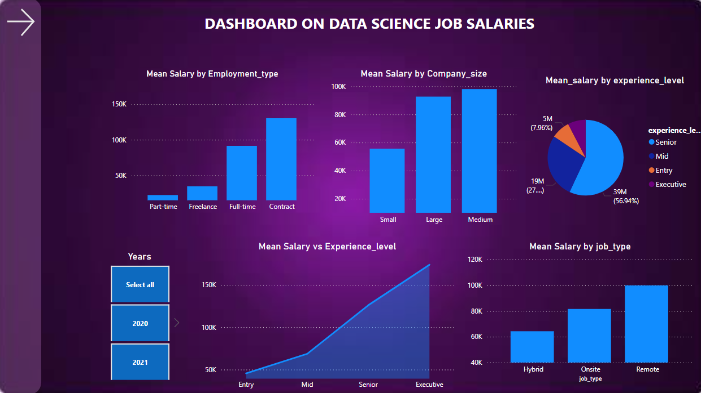

Slide 8
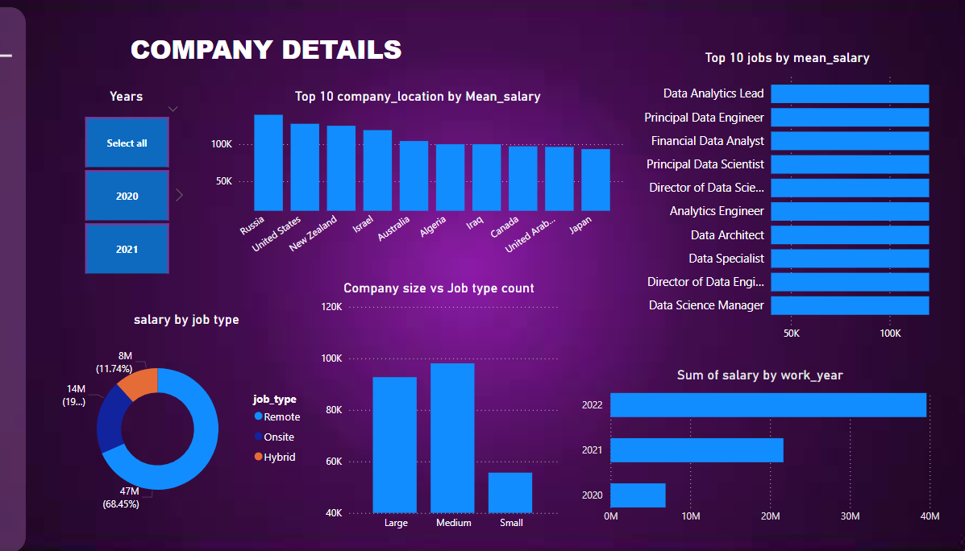

Slide 9
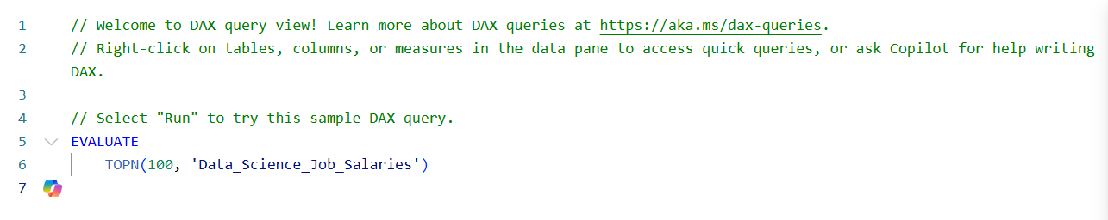
DAX QUERIES:
NOTE: Company locations are changed US,HN,NZ,UK to United States, Hangary, Newzeland, UnitedKindom by using AI

Slide 10
Conclusion & Next Steps
- Power BI effectively visualizes salary trends and job market insights.
- Potential improvements: Adding more datasets, industry comparisons.
- Next Steps: Share findings with stakeholders and refine analysis.

